Slide 1
Functions in C

Slide 2
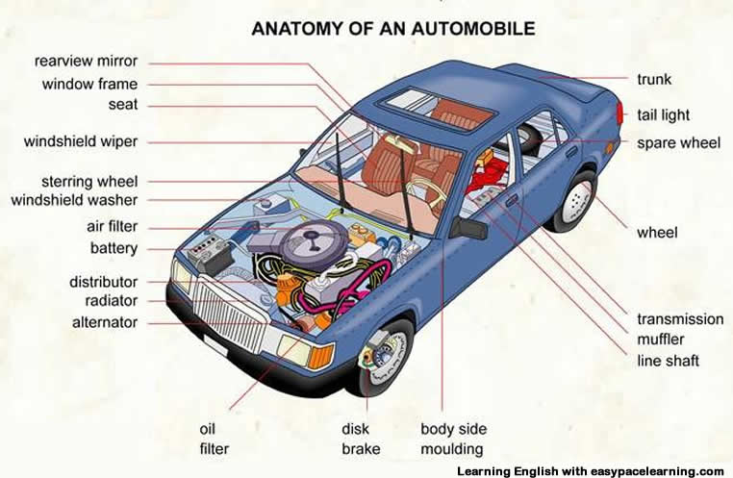

Slide 3
Modularity in Car
Each component in car is independently manufactured and tested
Can be fitted to any car

Slide 4
Used in Every Day Life
When a marriage is organized
Catering, decoration, music, seating arrangements, travel, boarding are modules
Each one is done independently
Rice + Dhal -> Idli
Can be separated to two modules
Preparing wet flour
Wet flour to Idlis

Slide 5
Tic Tac Toe - State of Board Problems
Given the board configuration of the tic tac toe game, determine if the board is in either of the following states: empty, player1 wins, player2 wins, draw or intermediate. The board is said to be in initial state if all the cells contain ‘-1’, player1 uses ‘1’ as his coin and player2 uses ‘2’ as his coin. The game is draw when the board is full and no one has won the game. The game is in intermediate state when no one has won and board is not full

Slide 6
Drawbacks of Previous Code
Previous code was 65 lines long
Difficult to understand and determine error
Better if it can be done through smaller modules
Part of code can be reused

Slide 7
Modules Tic Tac Toe - State of Board Problems
Read state of board
Count number of empty cells
Check if same coin is in a row
Check if same coin is in a column
Check if same coin is placed diagonally

Slide 8
Modules in Isogram Problem
Module to find factorial of a number

Slide 9
Modules in Accident Problem
Module to read values
Module to find mean of values
Module to find difference between values and mean
Print the values

Slide 10
Modules in Accident Problem
Module to read values
Module to find mean of values
Module to find difference between values and mean
Print the values

Slide 11
Functions in C
Modularity is supported in C by functions
All variables declared inside functions are local variables
Known only in function defined
Parameters
Communicate information between functions
Local variables

Slide 12
Syntax for Function Declaration
ftype fname (void);
void draw_circle(void);
Declarations and statements: function body (block)
Functions can not be defined inside other functions

Slide 13
Syntax for Function Definition
function header
{
statements
}
Syntax of function header
return_type function_Name(parameter_List)

Slide 14
Passing Arguments
Call by value
Copy of argument passed to function
Changes in function do not effect original
Use when function does not need to modify argument
Avoids accidental changes
Call by reference
Passes original argument
Changes in function effect original
Only used with trusted functions

Slide 15


Return Statement
return;
return expression;
Unlike Python C can return only value

Slide 16
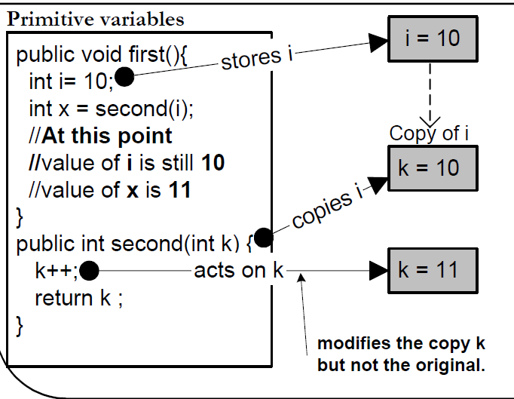
Pass by Value

Slide 17
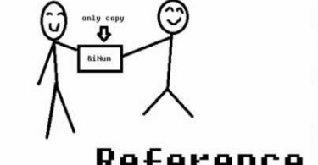

Slide 18
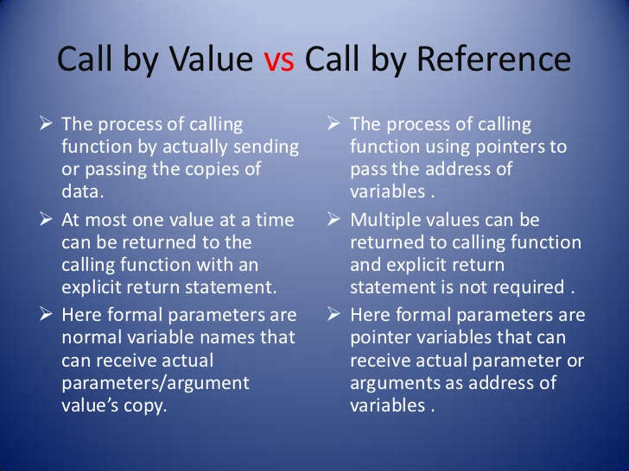

Slide 19
Pass by Address or Reference
Address of variable is passed
Pointer variables are used in function declaration and definition
Address of variable is got by prefixing variable name with an ‘&’
Pointer variables are declared with a ‘*’ in front
An integer pointer variable is declared as
int* a;
Value of an address is got by using ‘*’ operator

Slide 20
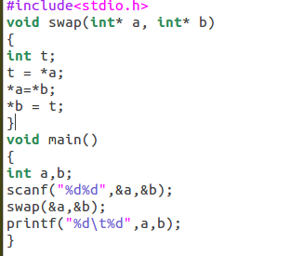

Slide 21
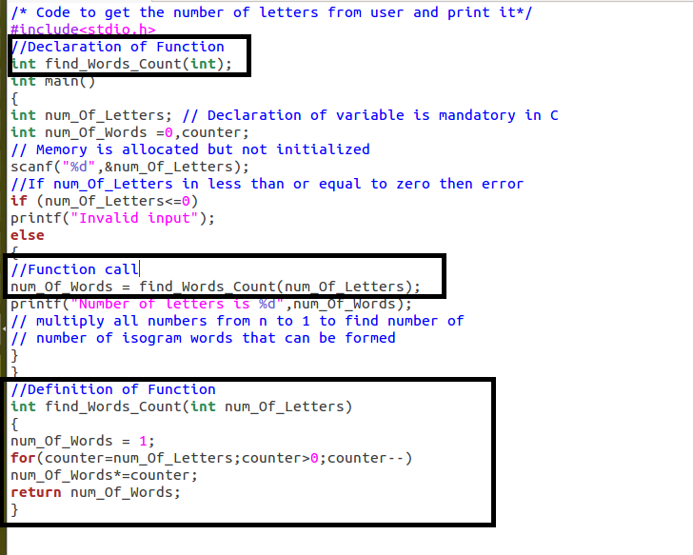
Isogram Problem with Functions

Slide 22
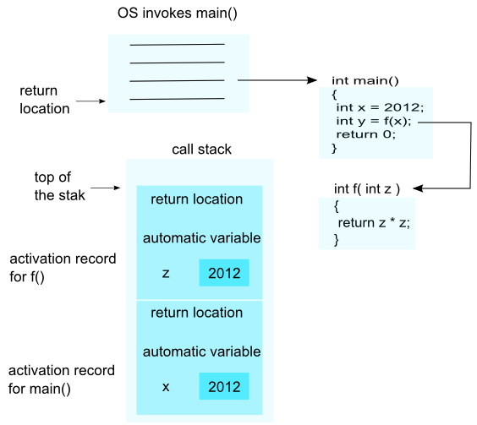

Slide 23
Default Passing Mechanisms
Primitive data types such as int, float, long, double, char are passed by value – so changes do not reflect in calling function
Arrays are passed by address – so changes reflect in calling function

Slide 24
Pass a Single Dimensional Array as Argument
Passed by reference or address by default
Changes made in function gets reflected in main()
Three ways to pass arrays in C all are same
Way1 | Way2 | Way3
void myFunction(int *a) { . . . } | void myFunction(int a[10]) { . . . } | void myFunction(int a[] ) { . . . }

Slide 25
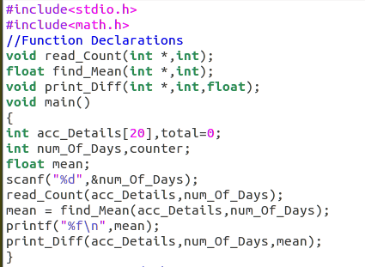

Slide 26
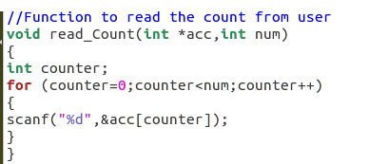

Slide 27
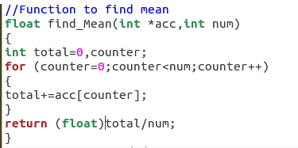

Slide 28
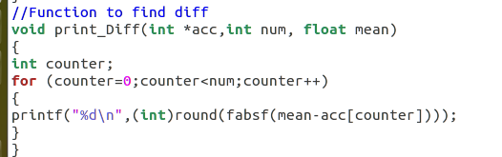

Slide 29
Passing 2D Array to Functions
#include <stdio.h>
const int n = 3;
void print(int arr[3][3], int m)
{
int i, j;
for (i = 0; i < m; i++)
for (j = 0; j < n; j++)
printf("%d ", arr[i][j]);
}
int main()
{
int arr[][3] = {{1, 2, 3}, {4, 5, 6}, {7, 8, 9}};
print(arr, 3);
return 0;
}

Slide 30
First Dimension is Optional
#include <stdio.h>
const int n = 3;
void print(int arr[][n], int m)
{
int i, j;
for (i = 0; i < m; i++)
for (j = 0; j < n; j++)
printf("%d ", arr[i][j]);
}
int main()
{
int arr[][3] = {{1, 2, 3}, {4, 5, 6}, {7, 8, 9}};
print(arr, 3);
return 0;
}

Slide 31
As a Single Dimensional Array
#include <stdio.h>
void print(int *arr, int m, int n)
{
int i, j;
for (i = 0; i < m; i++)
for (j = 0; j < n; j++)
printf("%d ", *((arr+i*n) + j));
}
int main()
{
int arr[][3] = {{1, 2, 3}, {4, 5, 6}, {7, 8, 9}};
int m = 3, n = 3;
print((int *)arr, m, n);
return 0;
}

Slide 32
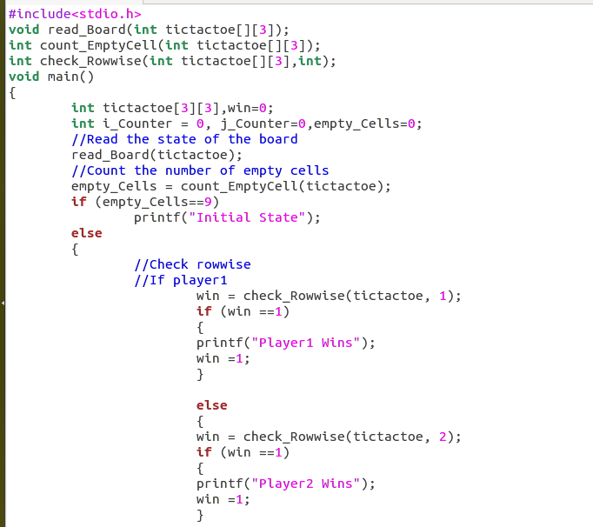

Slide 33
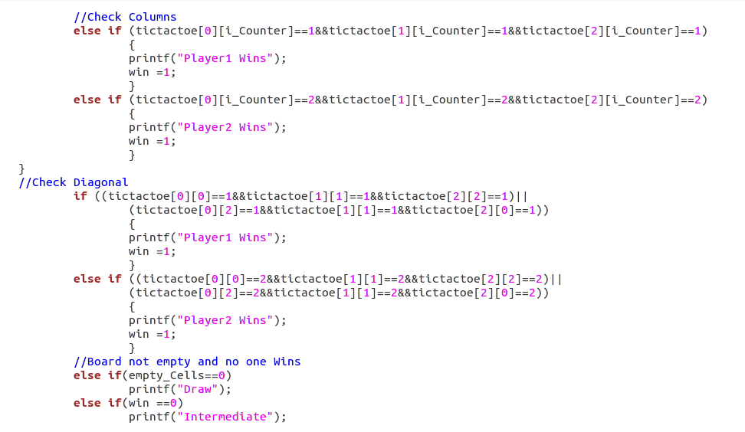

Slide 34
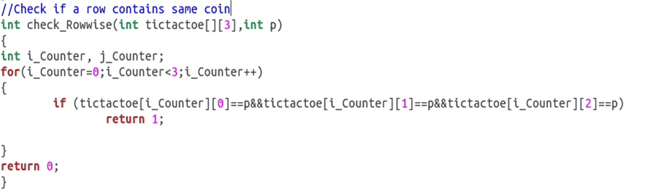

Slide 35
Recursion
Recursive functions
Functions that call themselves
Can only solve a base case

Slide 36

Consider a Big Classroom

Slide 37
Recursion in Real Life
John is seated in the last row of a very big classroom. Mike is sitting in last but one row of the same classroom. John wants to know how many rows are there in the classroom.
John: Hi Mike! Can you please say me in which row you are seated?
Mike: Yes… Of course John.
Mike ask the same question to Patil who is seated in front of him and so on… till Alice who is seated first row is asked the question
Alice: Alice can answer as one to Jack who is seated in the second row
This is the base case
Jack adds 1 to Alice's answer and tells it to Jill who is in the third row and so on… until the answer reaches John

Slide 38
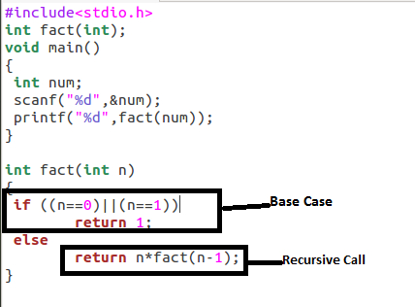
Factorial using Recursion

Slide 39
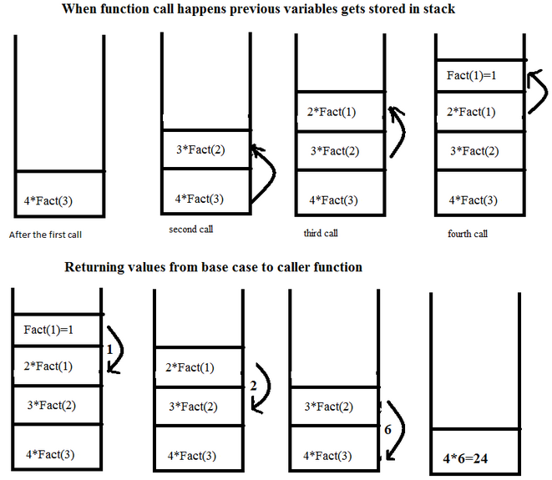

Slide 40
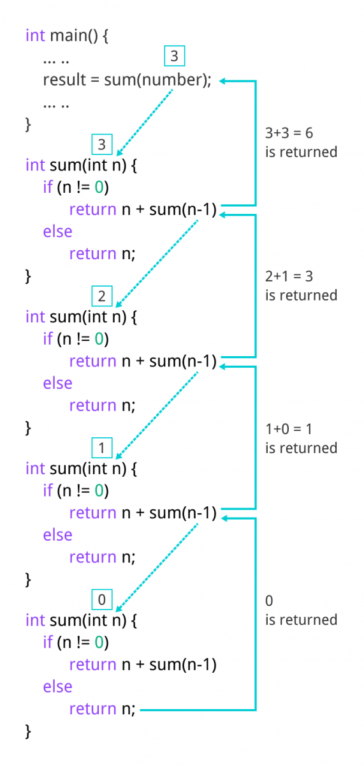

Slide 41
Fibonacci series
0, 1, 1, 2, 3, 5, 8...
int fibonacci( int n )
{
if (n == 0 || n == 1) // base case
return n;
else
return fibonacci( n - 1) + fibonacci( n – 2 );
}

Slide 42
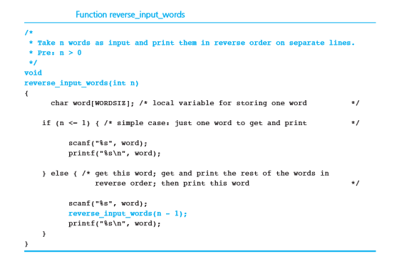

Slide 43
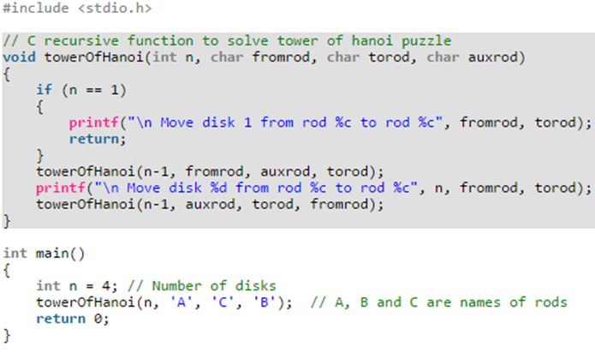

Slide 44
Recursion vs. Iteration
Repetition
Iteration: explicit loop
Recursion: repeated function calls
Termination
Iteration: loop condition fails
Recursion: base case recognized
Both can have infinite loops
Balance
Choice between performance (iteration) and good software engineering (recursion)

Slide 45
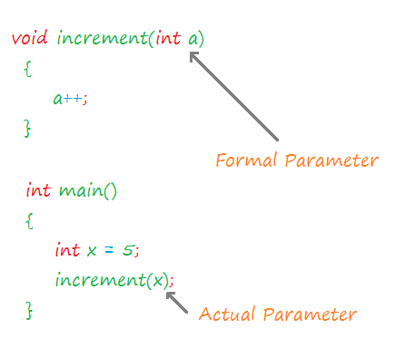

Slide 46
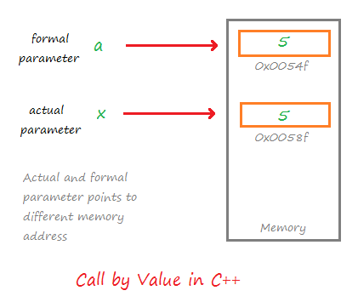

Slide 47
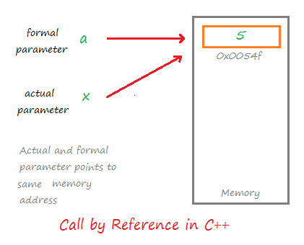

Slide 48
